Slide 1


Spring Cloud
Config Server, Circuit Breaker - Resilience4J

Slide 2


Agenda
1) Configuration management - Config Server
2) Circuit Breaker - Resilience4J

Slide 3
Configuration management - Config Server

Slide 4
What is a config server?
Image result for Configuration management - Config Server
Config Server is an externalized application configuration service. It is based on the open-source Spring Cloud Config project, which provides a centralized server for delivering external configuration properties to an application and a central source for managing this configuration across deployment environments

Slide 5
Config Server is an externalized application configuration service. It is based on the open-source Spring Cloud Config project, which provides a centralized server for delivering external configuration properties to an application and a central source for managing this configuration across deployment environments.
Spring Cloud Config includes support for a number of backends, including Git, HashiCorp Vault, and CredHub.
The Spring Cloud Services Config Server wraps the open-source Spring Cloud Config Server component, providing a managed service that is secured and maintained by VMware.
Its architecture is designed to minimize calls from the Config Server to external Git servers for the Git backend and to give operators greater control over the data fetched and served by the Config Server.
The Config Server can store secrets in CredHub and also supports HashiCorp Vault.

Slide 6
Architecture
Within a VMware Tanzu Application Service for VMs foundation, a "mirror service" makes a full mirror of each Git repository ("R1", "R2", "R3") used by a Config Server service instance.
The Config Server service instance, in turn, clones repositories from this mirror rather than cloning from the external Git server directly.

Slide 7
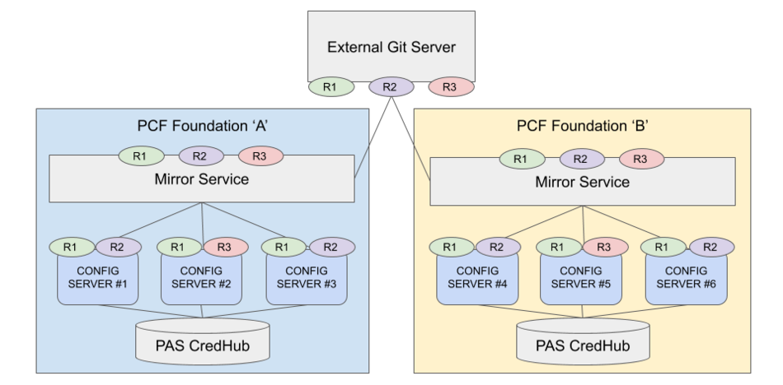

Slide 8
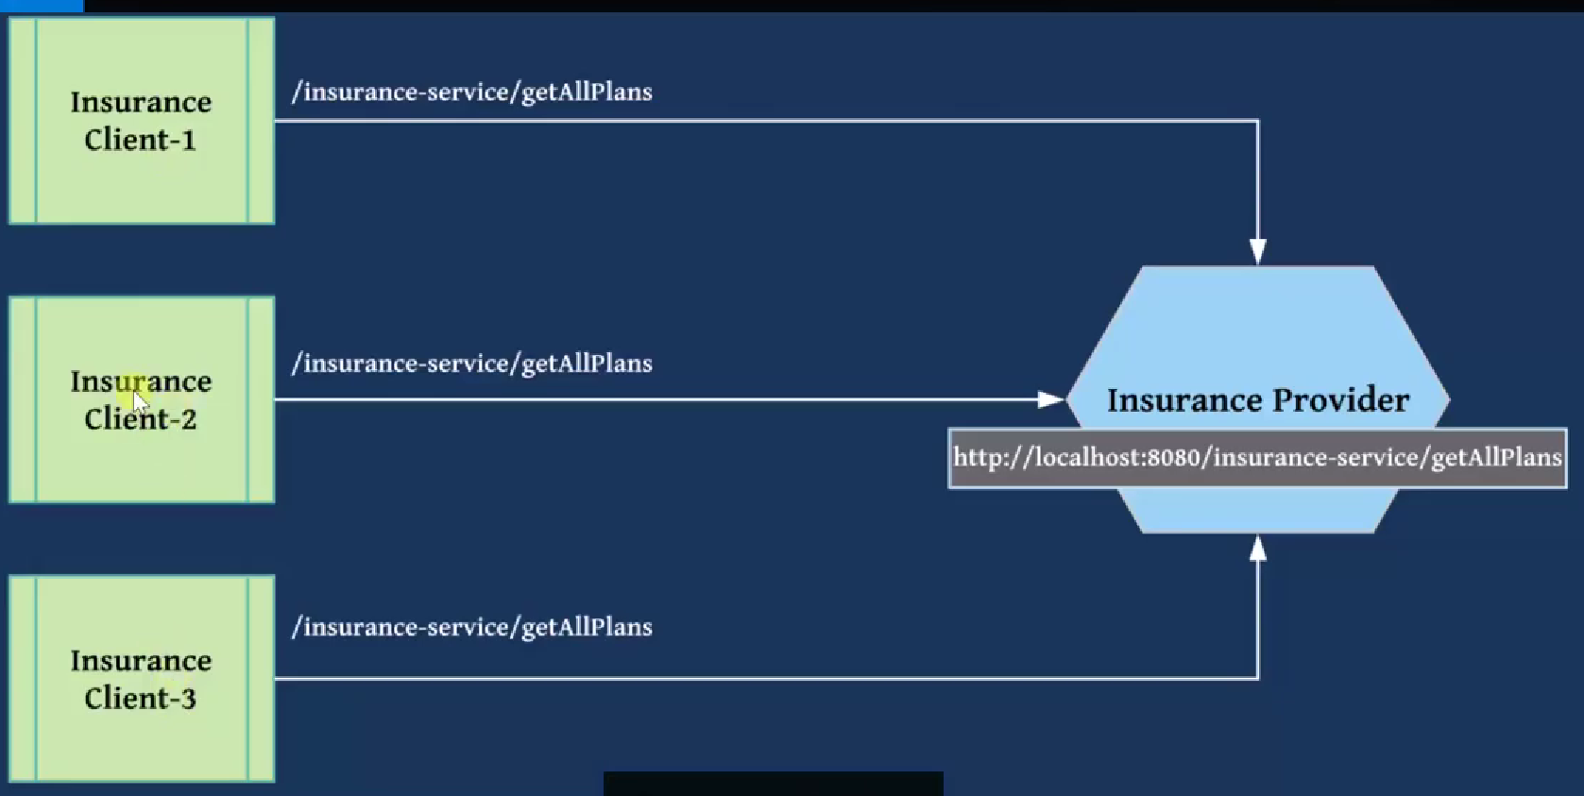

Slide 9
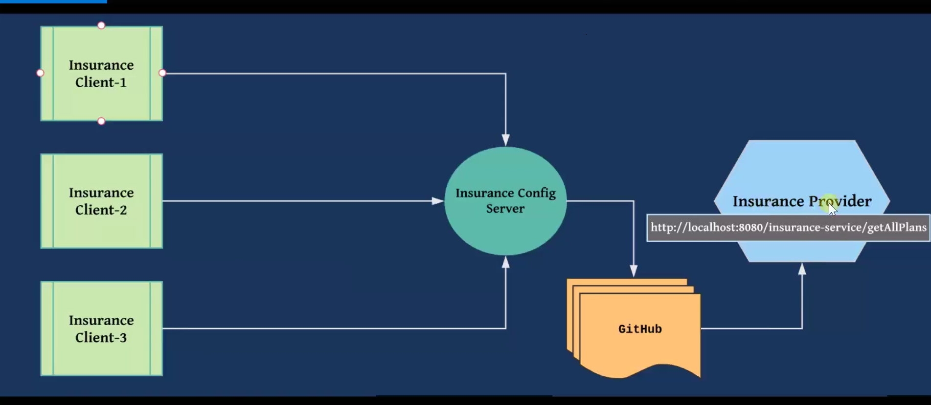

Slide 10
Reference Link
https://spring.io/guides/gs/centralized-configuration/

Slide 11
Circuit Breaker - Resilience4J

Slide 12
Circuit Breaker
The Circuit Breaker pattern is a popular design pattern used in Microservices Architecture, that falls under the Sustainable Design Patterns category. In Microservices architecture, a service usually calls other services to retrieve data, and there is the chance that the downstream service may be down.
It may be cause by slow network connection, timeouts, or temporal unavailability. Therefore, retrying calls can solve the issue. However, if there is a severe issue on a particular microservice, then it will be unavailable for a longer time.
In such case, the request will be continuously sent to that service, since the client doesn’t have any knowledge about a particular service being down. As a result, the network resources will be exhausted with low performance and bad user experience. Also, the failure of one service might lead to Cascading failures throughout the application.

Slide 13
Therefore, you can use the Circuit Breaker Design Pattern to overcome this problem. With the help of this pattern, the client will invoke a remote service through a proxy.
This proxy will basically behave as an electrical circuit breaker. So, when the number of failures crosses the threshold number, the circuit breaker trips for a particular time period.
Then, all the attempts to invoke the remote service will fail within this timeout period. After the timeout expires, the circuit breaker allows a limited number of test requests to pass through it.
If those requests succeed, the circuit breaker resumes back to the normal operation. Otherwise, if there is a failure, the timeout period begins again.

Slide 14
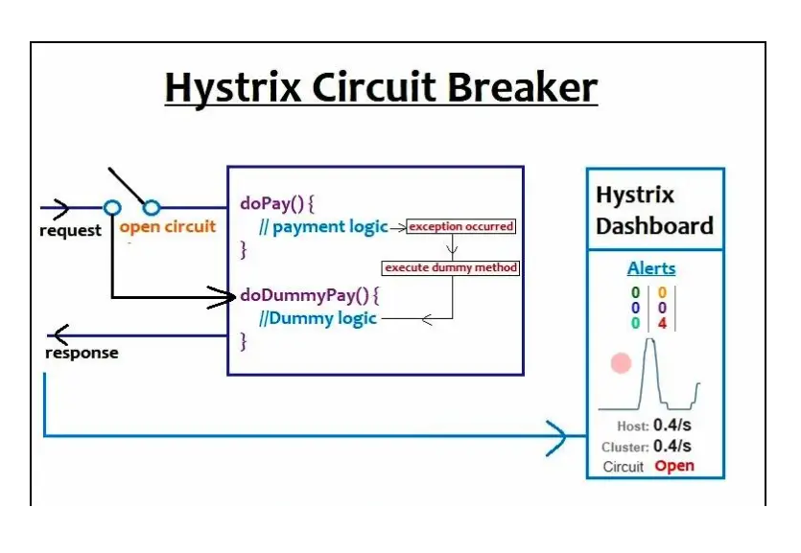
What is circuit breaker in microservices in Java?
In a microservice based application, Circuit Breaker is a technique, where we stop executing an erroneous method and redirect every request to a custom method (Fallback method). Generally, we stop execution of a particular method if it is continuously throwing an exception.

Slide 15
Why do we need a Circuit Breaker?
It’s very common for software applications to make remote calls to a software program, possibly running on different machines across a network.
One of the big differences between in-memory calls and remote calls is that remote calls may fail, or hang without a response until some timeout limit is reached.
What’s worse, if you have many requests on an unresponsive service, then you can run out of critical resources leading to cascading failures across multiple systems.
Michael Nygard in his wonderful book Release It has publicized the Circuit Breaker pattern to prevent this kind of fatal cascade. The basic idea behind the circuit breaker is very simple.
You wrap a protected function call in a circuit breaker object, which monitors for failures. Once the failures reach a certain threshold, the circuit breaker falls.

Slide 16
What is a Fallback Method in Microservices?
If an actual method of a microservice is throwing exception continuously, then we avoid execution of the actual logic for some time.
Instead, we redirect the request to a Dummy method that provides the response back to client’s request.
Such dummy method is called as Fallback method. This method can provide dummy responses such as ‘Service Not Working’, ‘Unable to Process’, ‘try after some time’ etc.

Slide 17
The Circuit Breaker Design pattern have three states:
Closed
Open
Half-Open

Slide 18
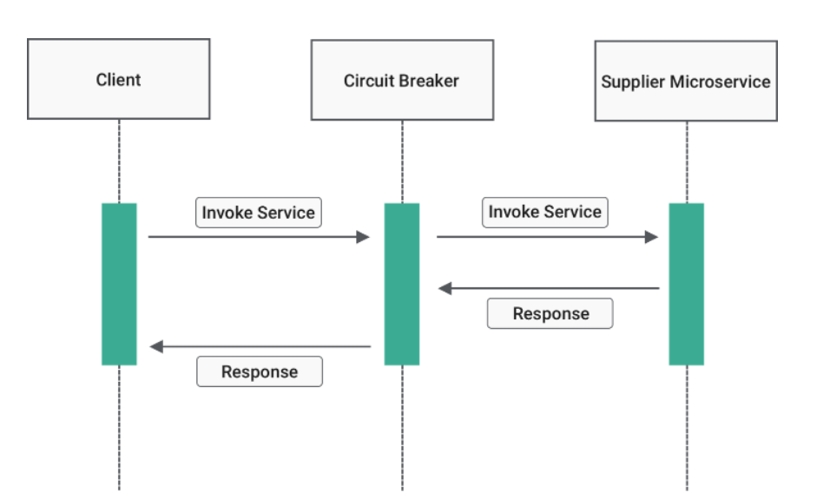
Closed state
In this state, the Circuit Breaker routs the requests to the Microservice and counts the number of failures in each period of time. That means it work without any failures. But if the number of failures in a certain period of time exceeds a threshold, the circuit will trip and will move to an “Open” state.

Slide 19
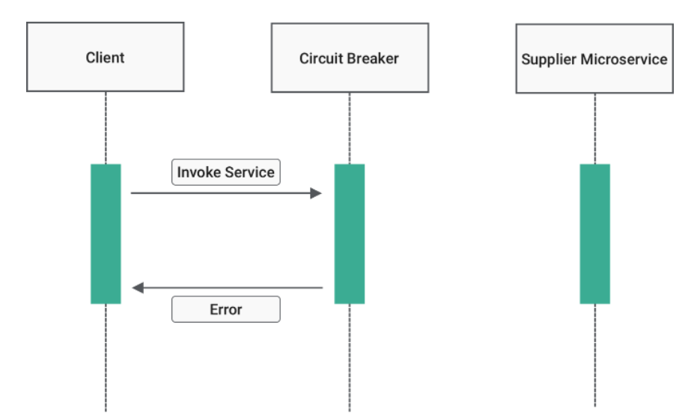
Open state
When Circuit breaker moves to the “Open” state, requests from the Microservices will fail immediately, and an exception will be returned. However, after a timeout, the Circuit Breaker will go to the “Half-Open” state.

Slide 20
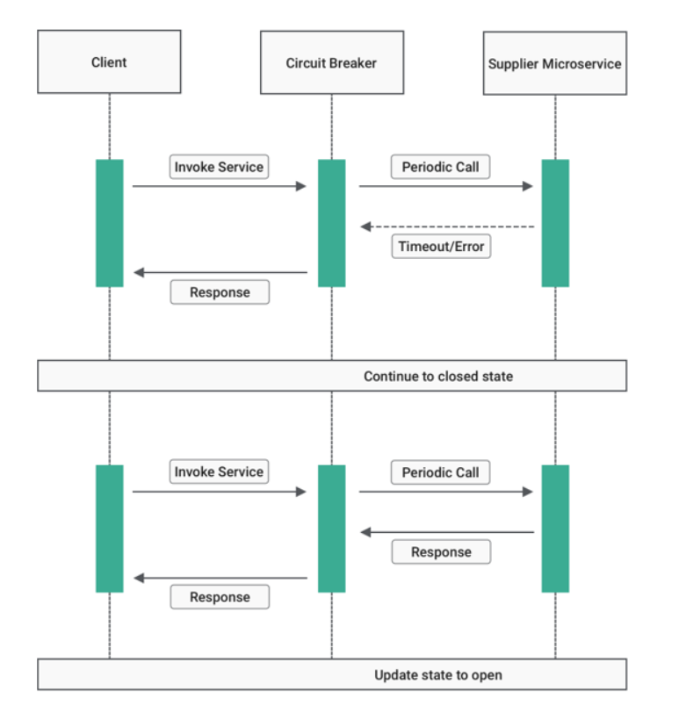
Half-Open state
In this state, the Circuit Breaker allows only a limited number of requests from the Microservice, to pass through and invoke the operation. If these requests are successful, the Circuit Breaker will go back to the “Closed” state. However, if any request fails again, it goes back to the “Open” state.

Slide 21
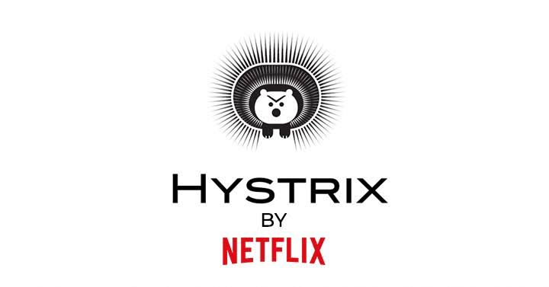

Slide 22

Hystrix Server
Hystrix server acts as a fault-tolerance robust system. It is used to avoid complete failure of an application.
It does this by using the Circuit Breaker mechanism. If the application is running without any issue, the circuit remains closed.
If there is an error encountered in the application, the Hystrix Server opens the circuit.
The Hystrix server stops the further request to calling service. It provides a highly robust system.

Slide 23
Fault Tolerance with Hystrix
Microservices must be extremely reliable because they depend on each other.
The microservice architecture contains a large number of small microservices.
These microservices communicate with each other in order to fulfill their requirements.
The instances of microservices may go up and down frequently.
As the number of interactions between microservices increases, the chances of failure of the microservice also increases in the system.

Slide 24
Fault Tolerance
Consider a scenario in which six microservices are communicating with each other.
The microservice-5 becomes down at some point, and all the other microservices are directly or indirectly depend on it, so all other services also go down.
The solution to this problem is to use a fallback in case of failure of a microservice. This aspect of a microservice is called fault tolerance

Slide 25
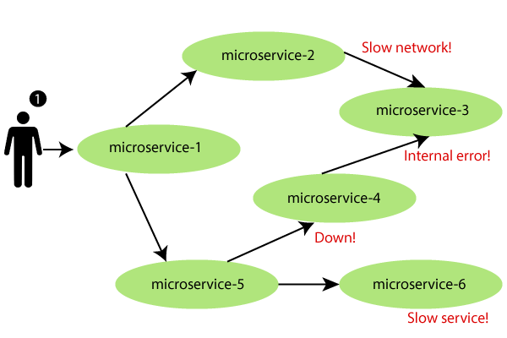

Slide 26
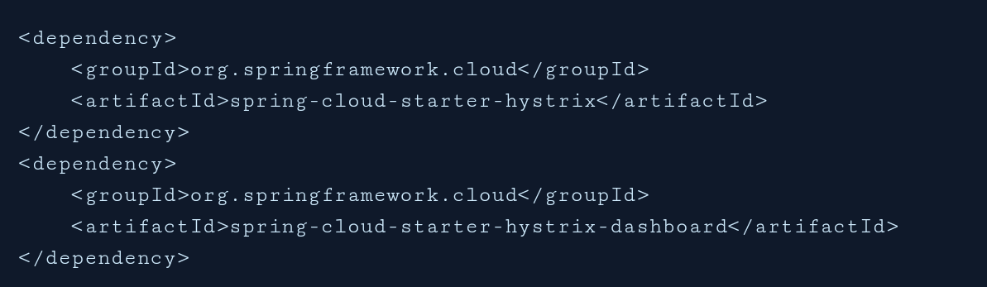
Hystrix configuration is done in four major steps.
Add Hystrix starter and dashboard dependencies
Add @EnableCircuitBreaker annotation
Add @EnableHystrixDashboard annotation
Add annotation @HystrixCommand(fallbackMethod = "myFallbackMethod")

Slide 27
Hystrix Circuit Breaker Pattern
Fault tolerance can be achieved with the help of a circuit breaker.
It is a pattern that wraps requests to external services and detects when they fail.
If a failure is detected, the circuit breaker opens.All the subsequent requests immediately return an error instead of making requests to the unhealthy service.
It monitors and detects the service which is down and misbehaves with other services. It rejects calls until it becomes healthy again

Slide 28
Hystrix Circuit Breaker Pattern – Spring Cloud
the Spring cloud Netflix stack component called Hystrix to implement circuit breaker while invoking underlying microservice.
It is generally required to enable fault tolerance in the application where some underlying service is down/throwing error permanently, we need to fall back to different path of program execution automatically.
This is related to distributed computing style of Eco system using lots of underlying Microservices. This is where circuit breaker pattern helps and Hystrix is an tool to build this circuit breaker.

Slide 29
Fallback method
The fallback method is a method that invokes when a fault occurs.
Hystrix allows us to define a fallback method for each service method

Slide 30
Sample coding

Slide 31
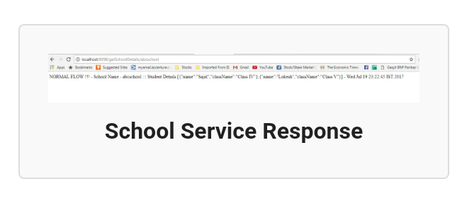

Slide 32
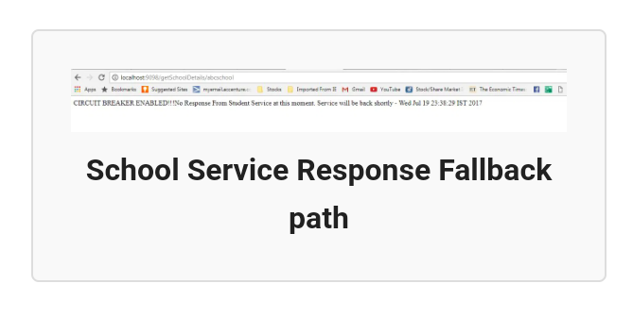

Slide 33
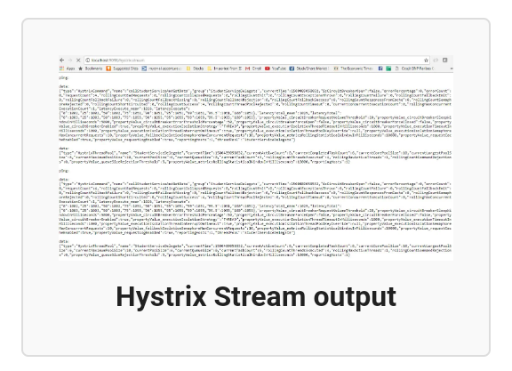

Slide 34
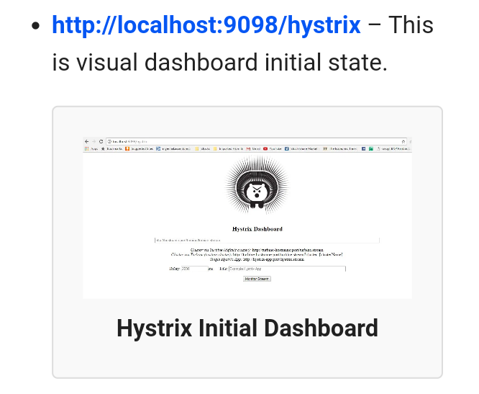

Slide 35
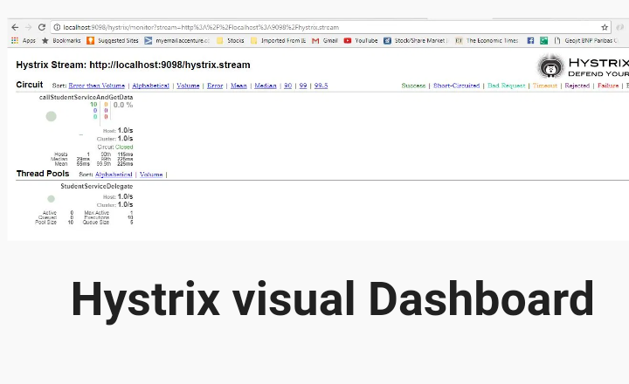

Slide 36
Resilience4J

Slide 37
Resilience4J
The library helps with implementing resilient systems by managing fault tolerance for remote communications.
The library is inspired by Hystrix but offers a much more convenient API and a number of other features like Rate Limiter (block too frequent requests), Bulkhead (avoid too many concurrent requests) etc.
<dependency>
<groupId>io.github.resilience4j</groupId>
<artifactId>resilience4j-circuitbreaker</artifactId>
<version>0.12.1</version>
</dependency>

Slide 38
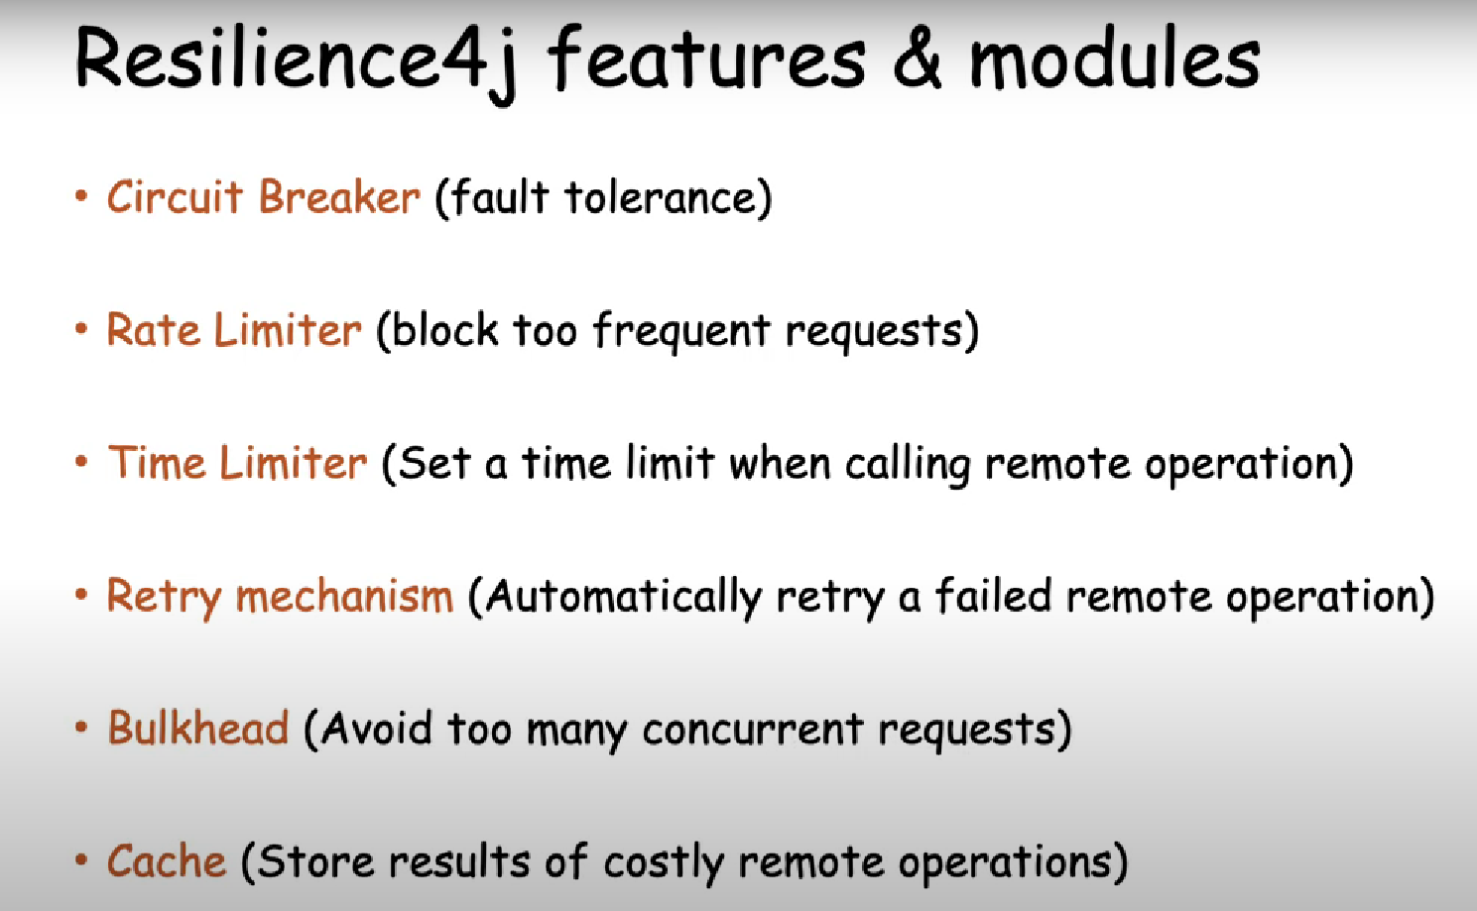

Slide 39
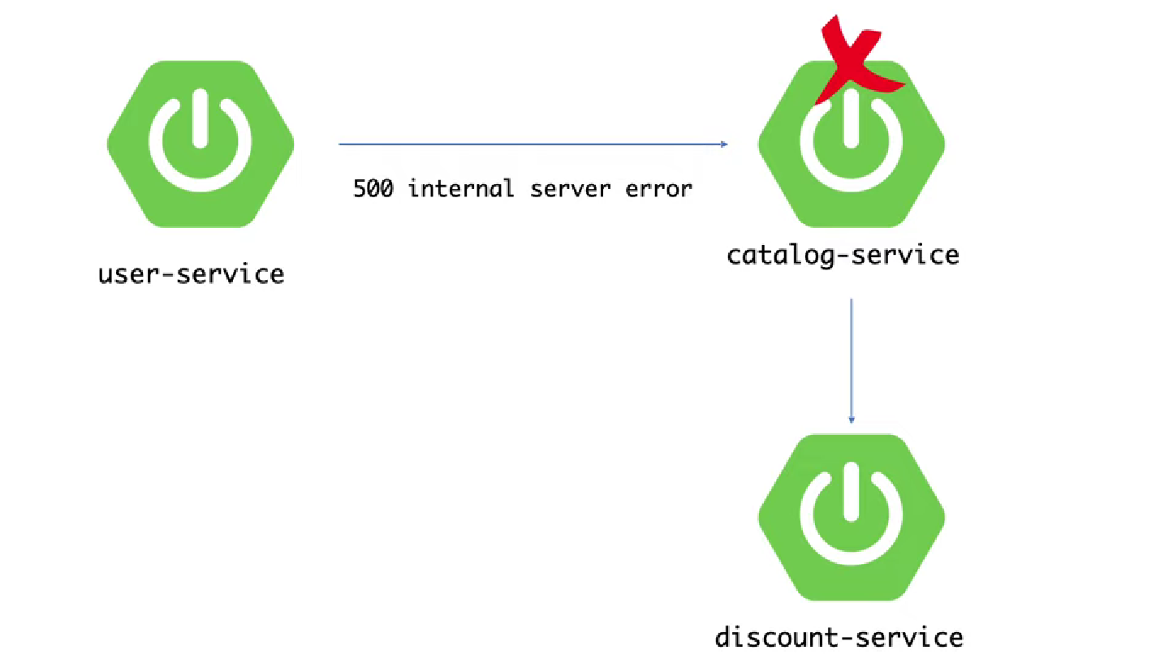

Slide 40
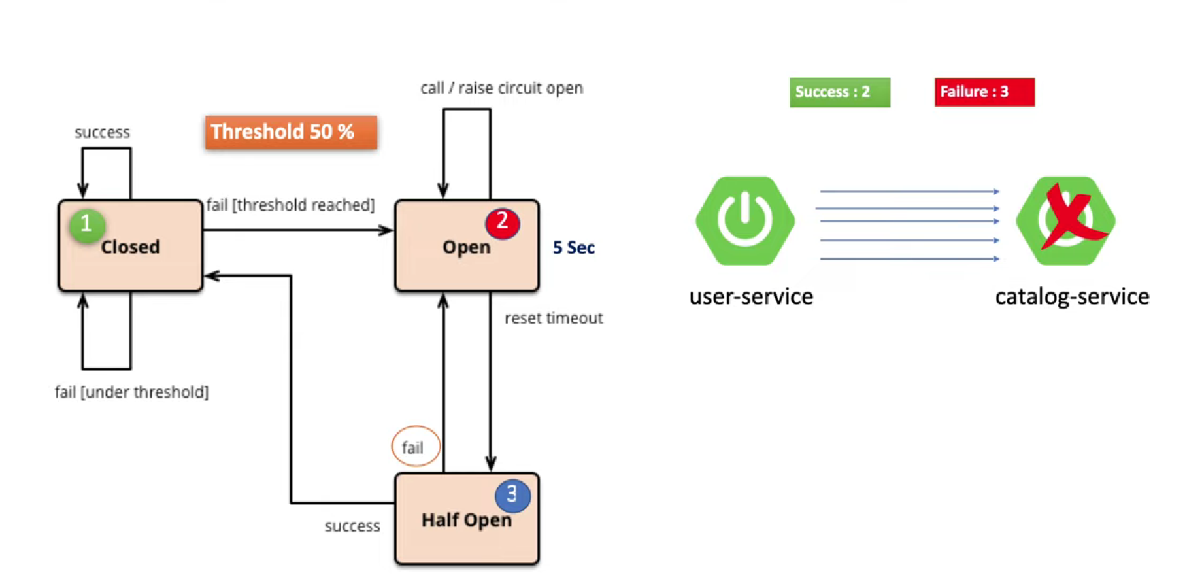

Slide 41


